Slide 1




Virtualisation of local market
Team Pirates
ARNAV CHAUHAN (TEAM LEADER)
PRAGYAN DIWAKAR
SOUMIK DUTTA

Slide 2



MARKET ANALYSIS
A recent survey revealed that 60% of consumers prefer purchasing from local sellers due to perceived quality and supporting local economies (Source: PwC, "Global Consumer Insights Survey 2022").
Many traditional market sellers lack access to technology, hindering their ability to create an online presence (Source: FICCI, "Digital Commerce in India: Opportunities and Challenges").
By aggregating products from multiple local sellers, these virtual market warehouses can provide a wide range of products across various categories, catering to diverse consumer needs (Source: IBEF, "E-commerce in India 2023").
The Indian e-commerce market is projected to reach approximately $200 billion by 2026, with a compound annual growth rate (CAGR) of around 27% from 2022 to 2026 (Source: IBEF, "E-commerce in India 2023").
DIGITAL COMMENCE GROWTH
CONSUMER BEHAVIOR
CHALLENGES
OPPERTUNITY

Slide 3
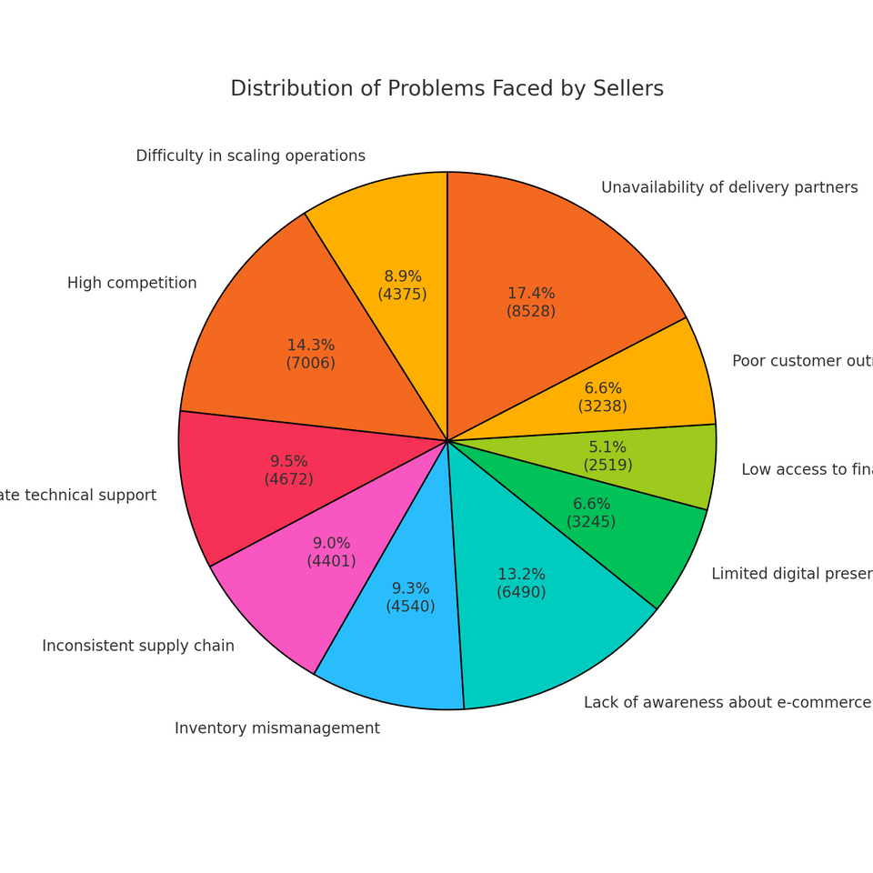


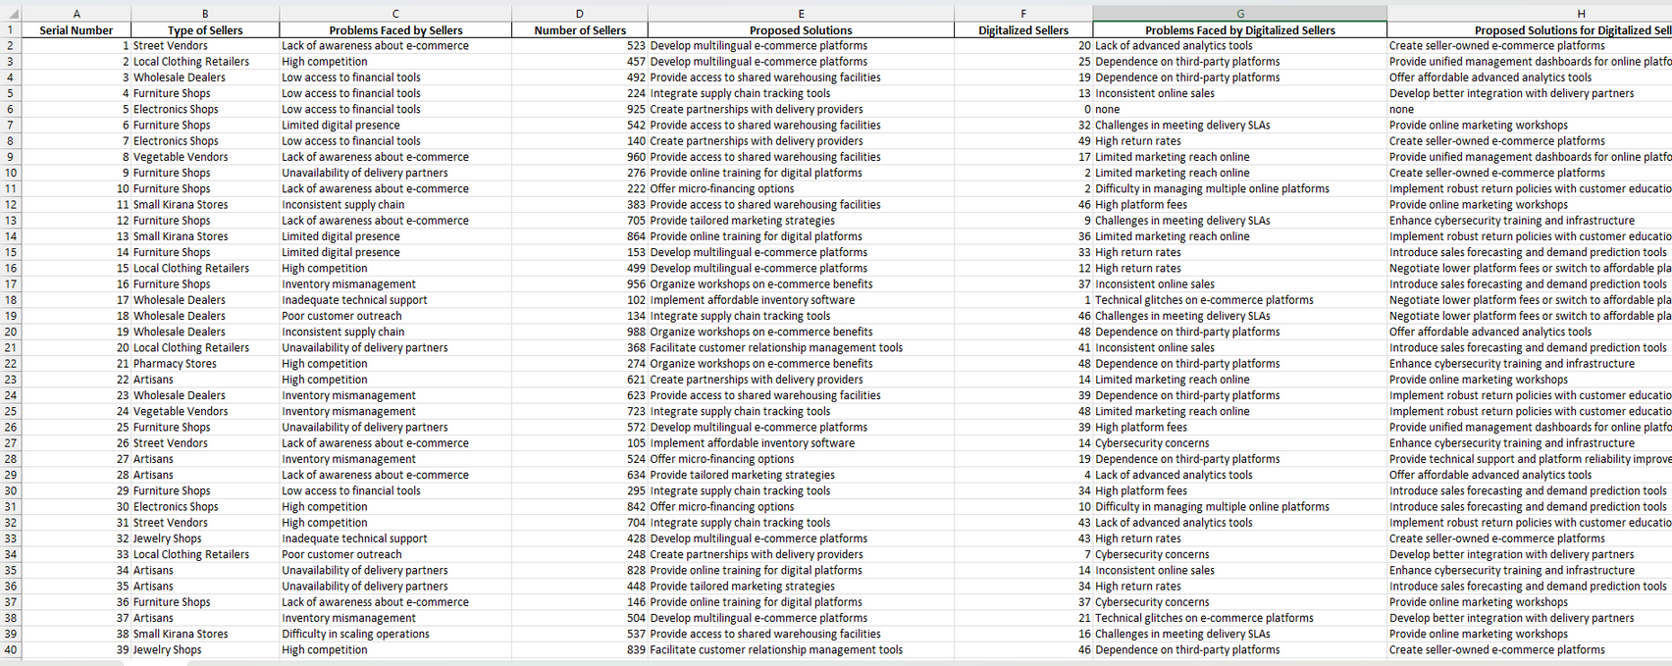
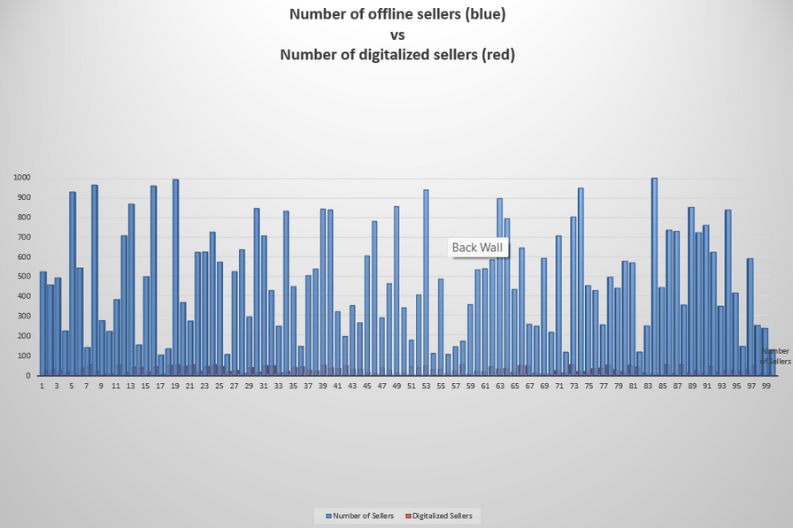
RESEARCH
Research done on the basis of sources
IBEF: "E-commerce in India 2023"
Statista: "E-commerce in India - Statistics & Facts"
McKinsey & Company: "The Future of E-commerce in India 2023"
PwC: "Global Consumer Insights Survey 2022"
Deloitte: "The 2023 Global Retail Industry Outlook"
BCG: "Retail 2025: The Future of E-commerce"
FICCI: "Digital Commerce in India: Opportunities and Challenges"
Accenture: "The Future of Logistics in E-commerce"
Page 05 of 07

Slide 4


TECHINAL ARCHITECTURE AND FEASIBILITY
APIS AND INTEGRATIONS
FRONTEND
CLOUD INFRASTRUCTURE
Payment Gateway Integration: Razorpay or Stripe for secure transactions.
Messaging APIs: Twilio or WhatsApp for multi-channel notifications.
Analytics Platforms: Integration with Google Analytics for insights.
REACT NATIVE
dynamic, responsive, and user-friendly interface.
AWS
BACKEND
Hosting: AWS or Google Cloud for scalable deployment.
EC2 instances for running microservices.
S3 for storing media files (product images, promotional videos).
Database Management: RDS for PostgreSQL and MongoDB Atlas for NoSQL data.
Serverless Functions: Lambda for executing notifications, automated reporting, and KYC verification
DJANGO (PYTHON)
powerful and feature-rich web framework for Python
SECURITY
DATABASE
Encryption: TLS for secure data transmission.
Compliance: GDPR-compliant data handling and encryption standards.
Monitoring: Use of tools like ELK Stack (Elasticsearch, Logstash, Kibana) for real-time system monitoring and anomaly detection.
POSTGRESQL
PostgreSQL for relational data like user profiles, transactions, and inventory.

Slide 5



Feasibility
01
02
03
Cost Effective
Performance Optimization
Secure and Reliable
Cloud-based architecture and serverless computing minimize upfront and operational costs.
Indexing, query optimization, load balancing, and Redis caching ensure efficient data handling and fast response times.
Robust cybersecurity, regular vulnerability assessments, and backup mechanisms ensure data safety and continuity.
04
05
Adaptable Design
Ease of Implementation
Modular architecture supports integration of new features and multi-device accessibility via PWA.s.
Leverages proven frameworks and tools for rapid development and deployment.

Slide 6


Dynamic Resource Allocation:
Automatically scale up or down server resources (CPU, memory) to match traffic demands, ensuring efficient utilization.
SCALABILITY
Distributed Traffic Management:
Horizontal scaling with additional nodes or servers balances user load and prevents bottlenecks during peak times.
Component-Level Flexibility
Microservices architecture enables independent scaling of specific functionalities (e.g., inventory, analytics) based on demand.
Cloud-Native Elasticity
Leverage AWS or GCP auto-scaling and load balancing for seamless expansion and uninterrupted performance.
6AGE
10/15
Performance Optimization:
Implement caching (e.g., Redis) and CDN integration for faster data delivery, while load balancers evenly distribute requests across servers.

Slide 7
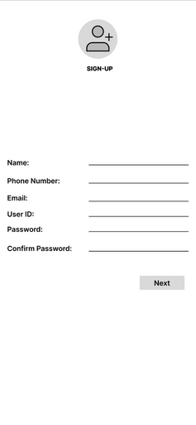
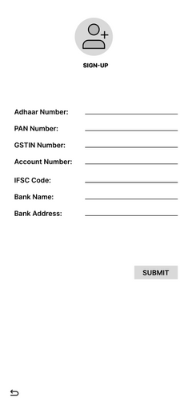
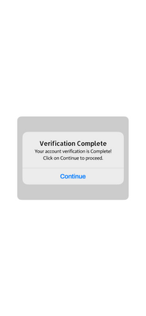
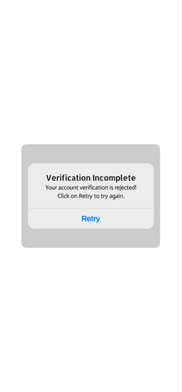

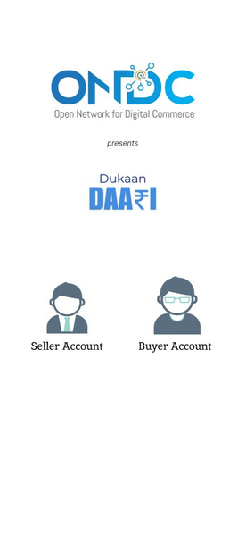
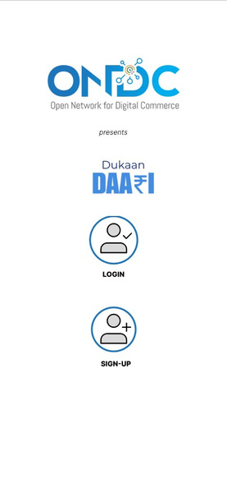
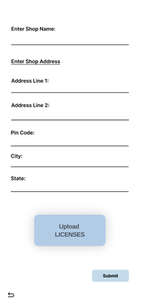
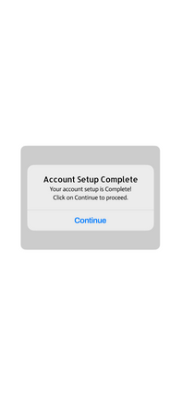
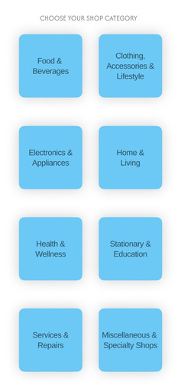
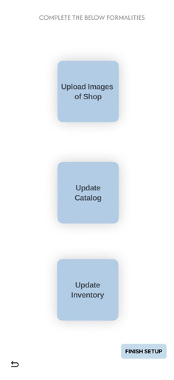
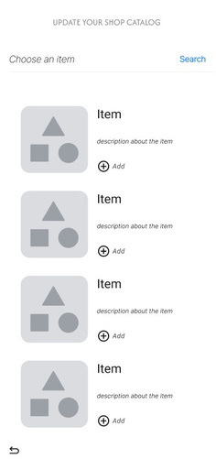
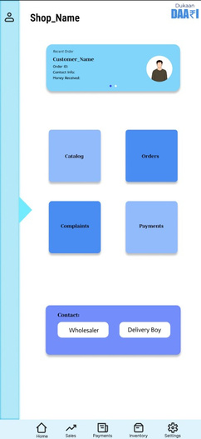
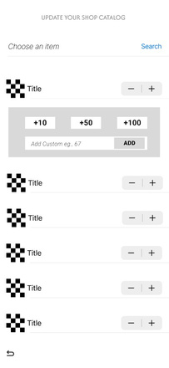
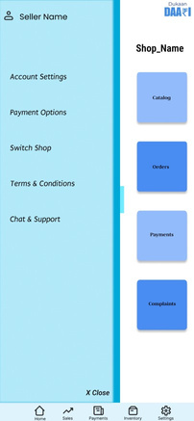

Wireframe

Slide 8

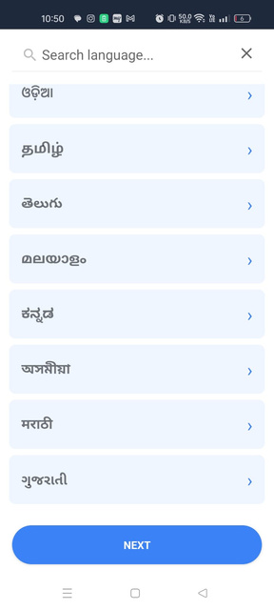
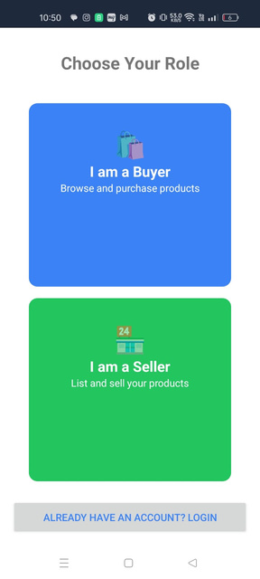
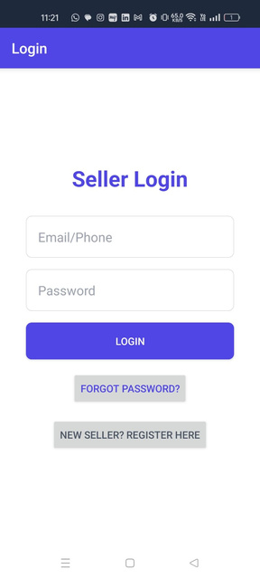
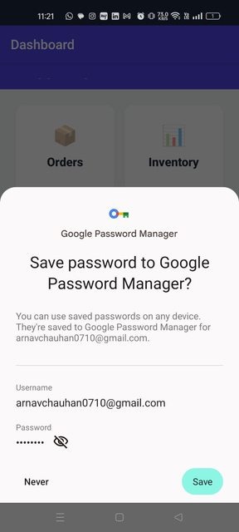
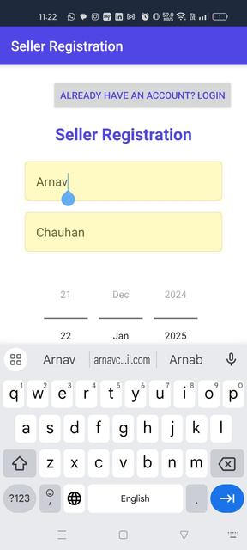
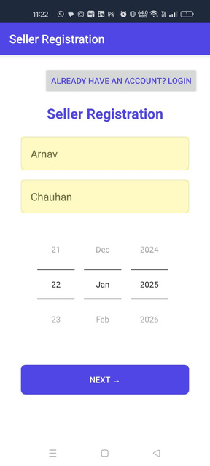
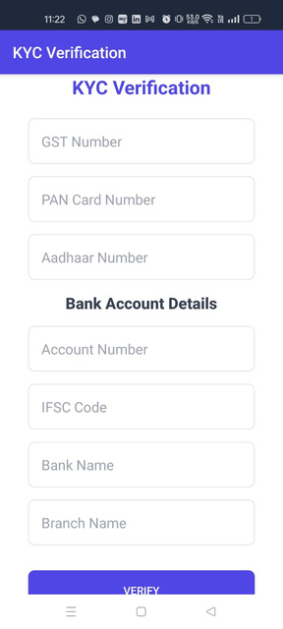
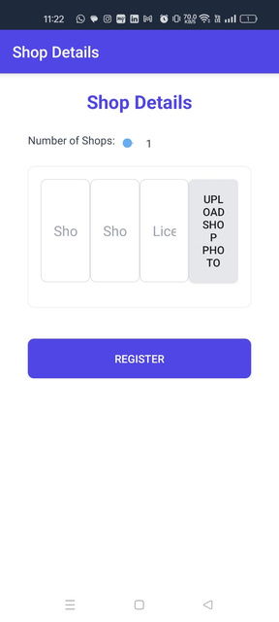
Onboarding

Slide 9



Allignment with ONDC’s Goal
Democratization of Commerce:
mpowers small sellers to compete in digital markets through virtual warehouses.
Technology Enablement:
Provides tools like SaaS-based POS, bulk uploads, and real-time inventory updates.
This alignment ensures that the solution not only meets ONDC’s immediate objectives but also fosters a scalable and sustainable digital commerce ecosystem. Let me know if you need further details or visual representations of this alignment!
Efficient Operations:
calable cloud architecture supports growth and ensures seamless performance.
Consumer Focus:
Offers diverse products, real-time updates, and faster deliveries via local fulfillment centers.

Slide 10





Thank you

